Slide 1
Back End Testing
INFO6255
Fall 2019
Medi Servattalab
M.Servattalab@northeastern.edu

Slide 2
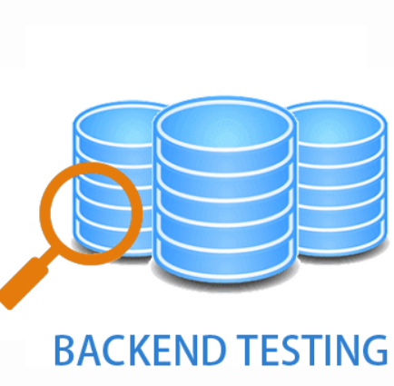
What is Back End Testing?
Back end Testing vs Front End Testing
  Front-End testing is the testing performed on the GUI or the Presentation Layer. Also called the Client Side testing.
  Back-End testing is a type of testing that checks the Server Side testing, which includes the Database testing.
    It also includes the Business Layer - API Testing

Slide 3
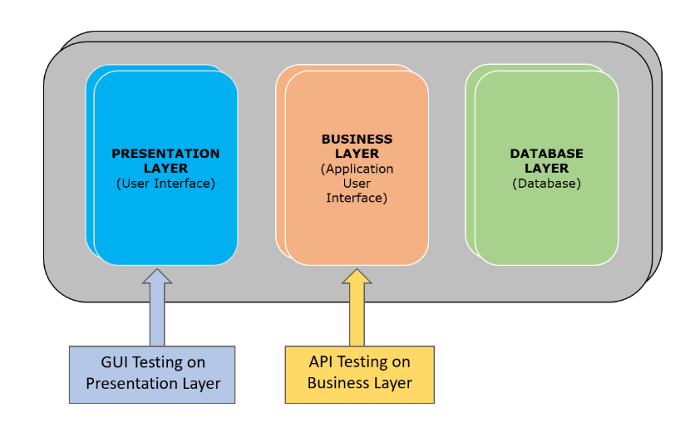
Back End Testing
3 Tiers of Architecture:
  Front end (Presentation Layer)
  Application (Business Layer)
  The Database Layer
https://dzone.com/articles/api-testing-and-automation-101-the-essential-guide

Slide 4
Different Types of Testing
Business & Functional Requirements
Integration Testing
Functional Testing
(Black Box Testing)
End to End Testing
Performance, Load & Stress Testing
User Acceptance Testing
Database Testing
Load and Stress Testing
https://dzone.com/articles/api-testing-and-automation-101-the-essential-guide

Slide 5

What is a Database Management System (DBMS)?
A Database Management System allows creation, definition and manipulation of database allowing users to store, process and analyze data easily. It allows:
  Creating a Database
  Storing Data
  Updating Data
  Accessing the Data
  Securing the Data
https://www.studytonight.com/dbms/overview-of-dbms.php

Slide 6
Database Management System (DBMS)
The DBMS manages 3 important items:
  The Engine – allows the data to be accessed.
  The Schema – defines the database logical structure.
  The Data - the actual data elements in the database.
A few DB examples:
  MySql
  Oracle
  SQL Server
  IBM DB2
  PostgreSQL
  Amazon SimpleDB (cloud based) etc.

Slide 7
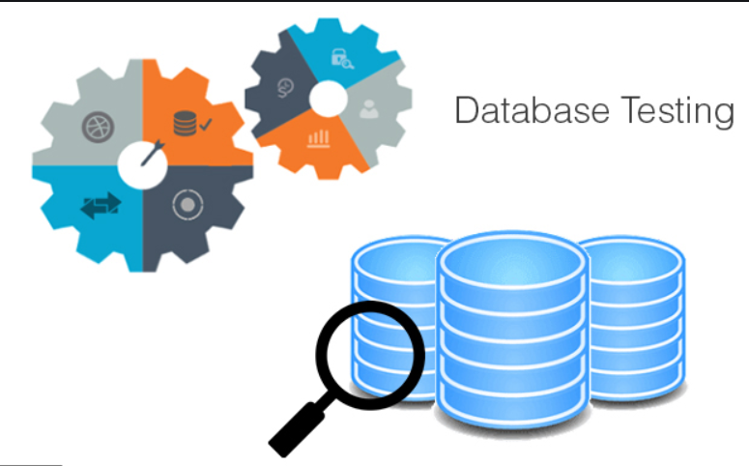
Why do the Database Testing??
Database testing also known as Back-end or data testing is one of the important types of testing.
The database must be tested functionally, along with load/stress testing to ensure security and performance.

Slide 8
Advantages and Disadvantages of DBMS
Advantages of DBMS
  Segregation of application program.
  Minimal data duplicity or data redundancy.
  Easy retrieval of data using the Query Language.
  Reduced development time and maintenance need.
  With Data Centers in the Cloud, we now have Database Management Systems capable of storing almost infinite data.
  Seamless integration into the application programming languages which makes it very easier to add a database to almost any application or website.
Disadvantages of DBMS
  It's Complexity
  It’s Cost. Except MySQL, which is open source.
  They are large in size.
https://www.studytonight.com/dbms/overview-of-dbms.php

Slide 9
Database Testing Added Value
Effective and efficient Database testing provides long-term functional stability to the overall application.
Database testing adds more value to the overall work by finding out hidden issues.
Any expenditure on database testing is a long-term investment which leads to long-term stability and robustness of the application.

Slide 10
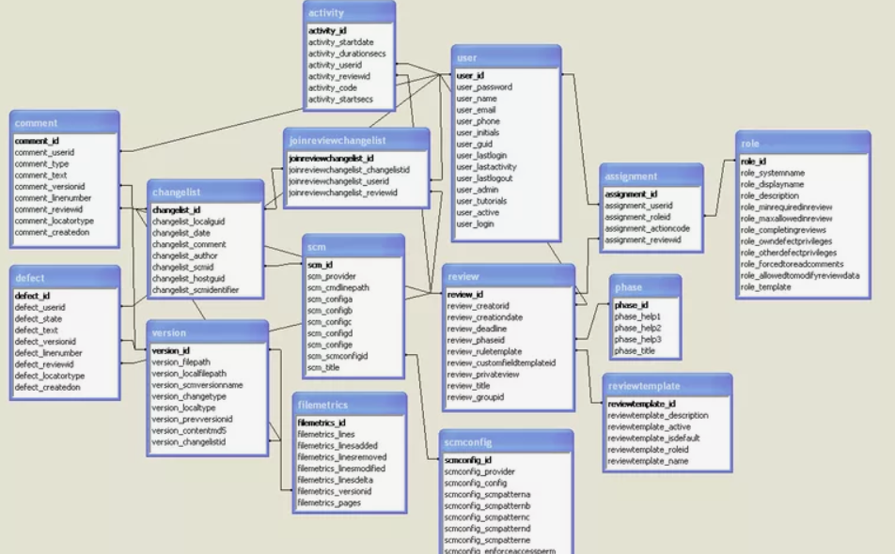
Database Testing
Testable items in the Relational Databases involves Validating:
  The schema
  Database tables
  Columns
  keys and indexes
  Stored Procedures
  Triggers
  Database server validations
  Data duplication Validation
https://www.guru99.com/data-testing.html#2

Slide 11
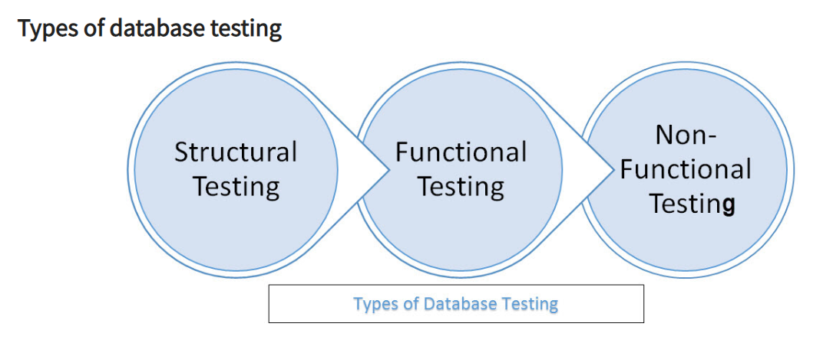
Types of Database Testing
3 Types of Database Testing:
  Structural Testing - the validation of all those elements inside the data repository that are used primarily for storage of data.
  Functional Testing - The requirement specification needs to ensure most of those transactions and operations as performed by the end users are consistent with the requirement specifications.
  Non-functional Testing - These can be Load Testing, Stress Testing, Security Testing, Usability Testing, and Compatibility Testing

Slide 12
1. Database Structural Testing
The Database Structural Testing includes the following:
  Schema Validation
  Database Tables/Colum Testing
  Stored Procedure Testing
  Trigger testing
https://www.guru99.com/data-testing.html

Slide 13
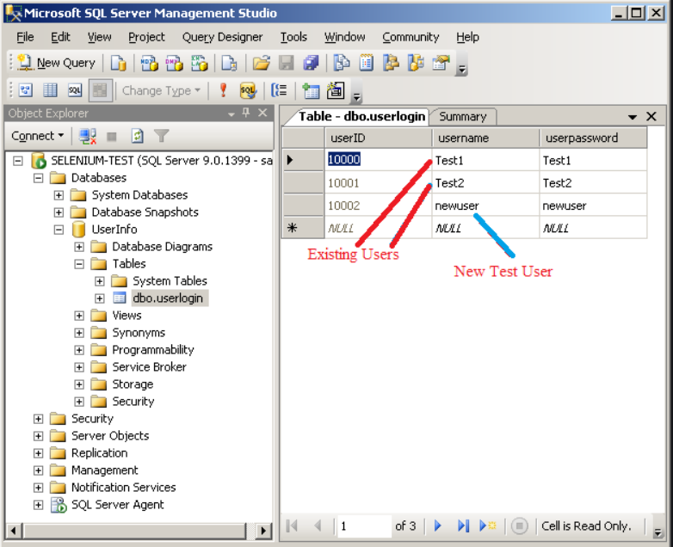
1. Database Structural Testing
Schema Validation
  The schema mapping between the front end and the back end.
  Any unmapped columns or tables or views. Use the mapping testing tools for validating database schemas:
    DBUnit Integrated with Ant
    SQL S
https://www.guru99.com/data-testing.html

Slide 14
1. Database Structural Testing
Database Tables/Colum Testing
  Mapping of the database fields and columns in the back end against the mappings in the front end.
  The length and naming convention of the database fields and columns against the requirements.
  Validation of the presence of any unused/unmapped database tables/columns.
  Validation of the compatibility of the data type and field lengths.
  Check the Primary and Foreign keys constraints
    Check references for foreign keys are valid
    Check for the data types of the primary key and the corresponding foreign keys
    Naming conventions for all keys and indexes

Slide 15
1. Database Structural Testing
Stored Procedure Testing
  Coding standard conventions
  Exception and error handling
  Cover all the conditions/loops by applying the required input data did properly apply the TRIM operation
  Provides the end user with the required result (Manual)
  Ensures the table fields are being updated as required by the application under test
  Enables the implicit invoking of the required triggers
  Presence of any unused Stored Procedures
  Null condition which can be done at the database level
  Integration of the stored procedure modules as per as the requirements of the application under test

Slide 16
1. Database Structural Testing
Trigger testing
  Coding conventions have been followed during the coding phase of the Triggers.
  The triggers executed for the respective DML transactions have fulfilled the required conditions.
  The trigger updates the data correctly once they have been executed.
  Validation of the required Update /Insert /Delete triggers functionality in the realm of the application under test.
DML (Data Manipulation Language)

Slide 17
2. Functional Database Testing
You need to ensure most of the transactions & operations as performed by the end users are consistent with the requirement specifications.
  What to look for:
    Field is mandatory while allowing NULL values on that field.
    The length of each field is the correct size?
    Similar fields have same names across tables?
    Are there any computed fields present in the Database?

Slide 18
2. Functional Data Base Testing…
  Is the data logically well organized
  Is the data stored in the tables correct and as per the requirements.
  Are there any unnecessary data present in the application under test.
  Has the data been stored as per as the requirement with respect to data which has been updated from the user interface.
  Has the TRIM operations performed on the data before inserting data into the database under test.

Slide 19
2. Functional DB Testing
  Has the data been properly committed if the transaction has been successfully executed as per the requirements.
  Can the data be rolled backed successfully if the transaction has not executed successfully by the end user.
  Whether all the transactions have been executed by using the required design procedures as specified by the system requirement

Slide 20
2. Functional Database Testing…
Login and user security
The application prevents the user to proceed further in the application in case of a
  invalid username but valid password
  valid username but invalid password.
  invalid username and invalid password.
  valid username and a valid password.
The user is allowed to perform only those specific operations which are specified by the business requirements.
The data secured from unauthorized access.
Are different user roles created with different permissions?

Slide 21
2. Functional Database Testing
Do all users have required levels of access on the specified Database as required by the business specifications.
Check that sensitive data like passwords, credit card numbers are encrypted and not stored as plain text in database.
Ensure all accounts should have passwords that are complex and not easily guessed.

Slide 22
3. Non Functional Testing
The Non Functional Testing can be
  Load testing
  Stress Testing
  Security Testing
  Compatibility Testing
  The database must be tested functionally, along with load/stress testing to ensure security and performance.
  Minimum System Requirements
    Ensuring that the minimum System requirements have been met per the requirements.

Slide 23
Data base Load and Stress Testing
Overhead is great but the results are very valuable.
Should include the most frequently used user transactions.
The observation of the effective fetch times.
Stress test to identify the breakdown points.
Test data generation should be considered.
Should be able to restore the database after the test to its original state for retests.
Tools used: Load Runner and JMeter

Slide 24
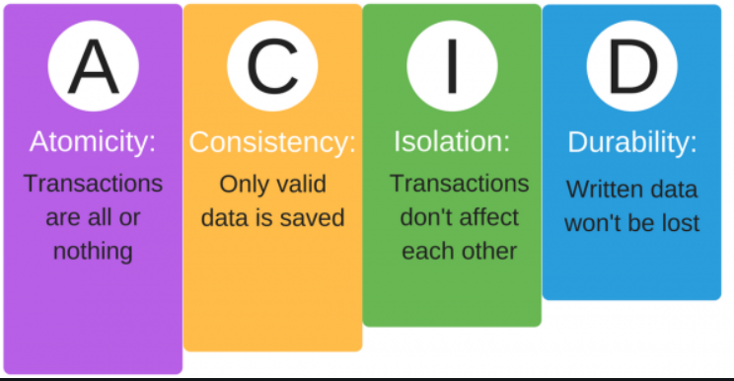
ACID Properties Test
ACID is an acronym that stands for Atomicity, Consistency, Isolation and Durability:
Atomicity
  You guarantee that either all of the transaction succeeds or none of it does.
    If one part of the transaction fails, the whole transaction fails. With atomicity, it’s either “all or nothing”.
Consistency
  You guarantee that all data will be consistent.
    All data will be valid according to all defined rules, including any constraints, cascades, and triggers that have been applied on the database.

Slide 25
ACID Properties Test
Isolation
  Guarantees that all transactions will occur in isolation. No transaction will be affected by any other transaction.
    So a transaction cannot read data from any other transaction that has not yet completed.
Durability
  Once a transaction is committed, it will remain in the system – even if there’s a system crash immediately following the transaction.
    Any changes from the transaction must be stored permanently. If the system tells the user that the transaction has succeeded, the transaction must have, in fact, succeeded.
https://database.guide/what-is-acid-in-databases/

Slide 26
Open Source Database Testing Tools
Database Benchmark - designed to stress test databases with large data flows.
Database Rider - aims to bring DBUnit closer to your JUnit tests so database testing will feel like a breeze!
DbFit - Supports easy test-driven development of your database code.
Dbstress - performance and stress testing tool written in Scala and Akka.
DbUnit - is a JUnit extension targeted at database-driven projects that, among other things, puts your database into a known state between test runs.
DB Test Driven - Database test-driven is an open source unit testing framework for database test-driven development.
HammerDB - is an open source database load testing and benchmarking tool.
https://www.softwaretestingmagazine.com/tools/open-source-database-testing-tools/

Slide 27
DB Automation Tools
The best automation tool for Database testing are listed as follows:
DataGrip - a powerful GUI tool for SQL. Smart code completion, on-the-fly analysis, quick-fixes, refactorings that work in SQL files, and more.
Datafactory - a commercial database testing tool works as data generator and data manager for database testing.
Mockupdata - Rapidly generates huge amount of data and examines multiple tables at a time for relationship along with foreign key

Slide 28
DB Automation Tools
DTM Data Generator - is a commercial tool for generating data rows and schema objects for database testing
    Supports Load Testing, Usability Testing and Performance Testing on database.
SQL test - uses open-source tSQLt framework, views, stored procedures and functions.
    Allows to run unit tests for SQL Server databases.
  tSQLt - is specifically designed as commercial database unit testing framework dedicated to Microsoft SQL Server

Slide 29
References
https://www.softwaretestingmagazine.com/tools/open-source-database-testing-tools/
http://www.agiledata.org/essays/databaseTesting.html
http://www.methodsandtools.com/tools/dbfit.php
https://www.guru99.com/data-testing.html
https://www.studytonight.com/dbms/overview-of-dbms.php
https://searchsqlserver.techtarget.com/definition/database-management-system
https://www.quora.com/What-is-the-best-automation-tool-for-database-testing

Slide 30
API (Application Programming Interface) Testing
What is API Testing?
(WebServices vs. API)

Slide 31
API Testing (Application Programming Interface)
API testing is a software testing type which focuses on determining if the developed APIs meet the following expectations of the Application:
  Functionality
  Reliability
  Performance
  Security
The API Testing is done at the Messaging Layer.
The number of API testers automating more than 50% of their tests is expected to grow by 30% (from 59% to 77%) in the next two years.
API testing is a crucial component of a success CI/DevOps practice.

Slide 32
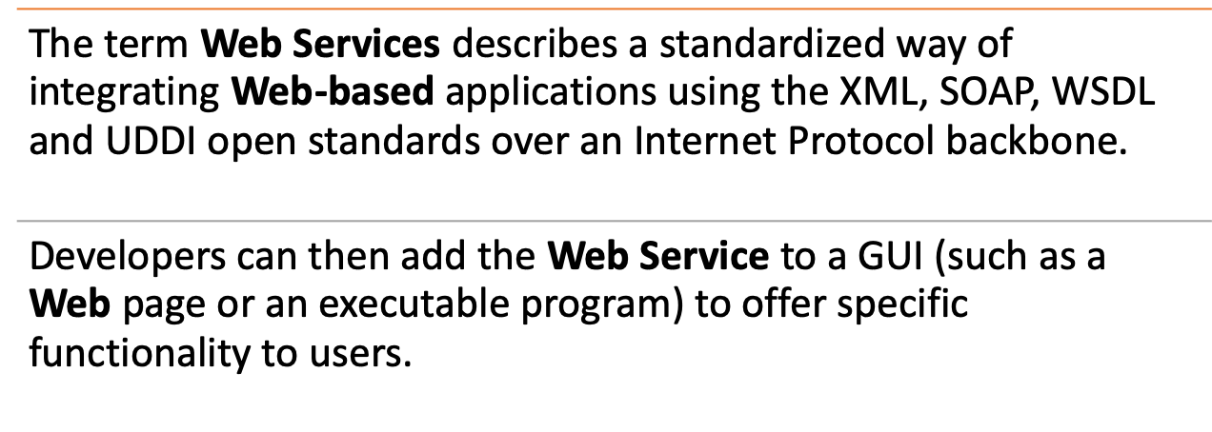
Web Services

Slide 33
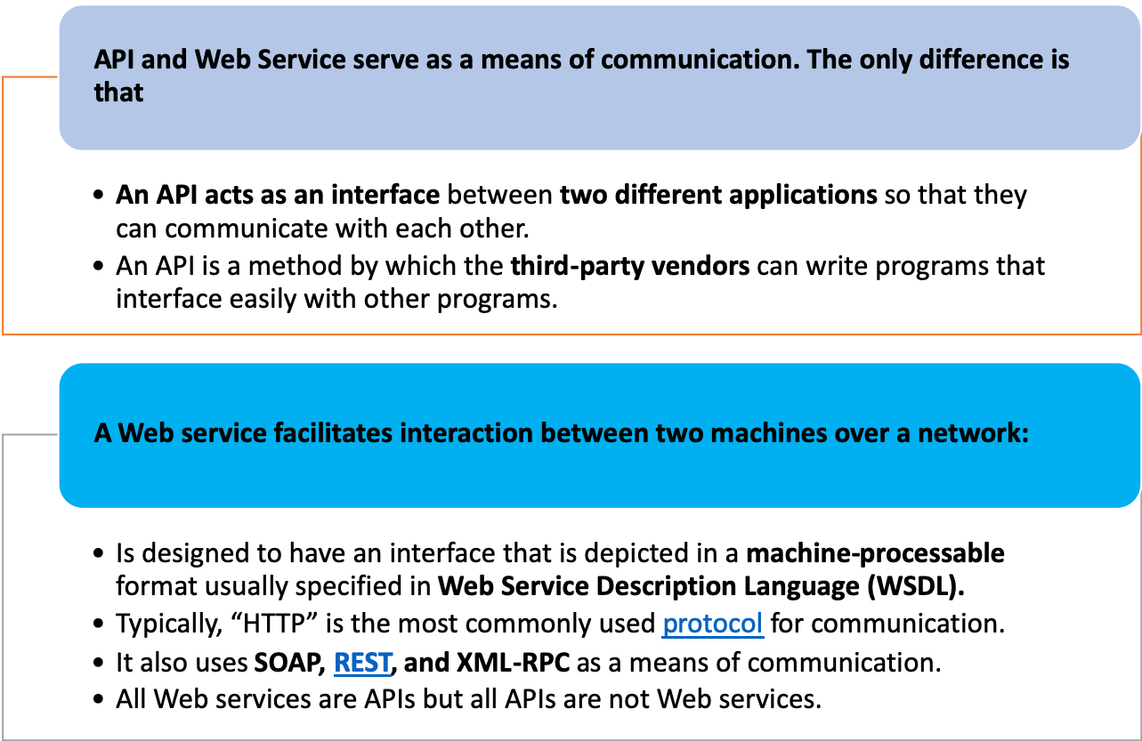
API vs Web Service

Slide 34
Web Services Components & Operation
Web Services Components:
The basic web services platform is XML message format and HTTP request and response. All the standard web services work using the following components
  SOAP (Simple Object Access Protocol)
  UDDI (Universal Description, Discovery and Integration)
  WSDL (Web Services Description Language)
Web services Operation:
A web service enables communication among various applications installed on different devices by using open standards:
  HTML page to send the request and render the received the response via HTTP/HTTPS protocol.
  XML to tag the request and response data.
  SOAP to transfer a message over the web.
  WSDL to describe the availability of web service.

Slide 35
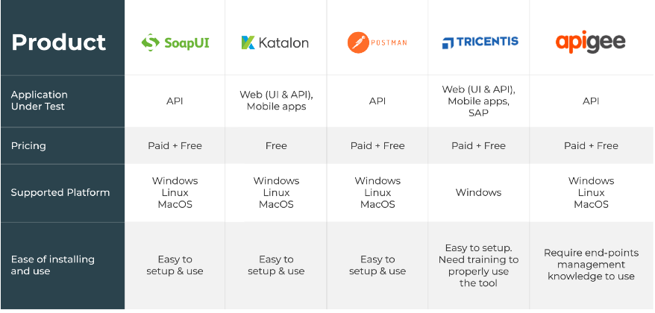
Top 5 API Testing Tools for 2018
https://medium.com/@alicealdaine/top-10-api-testing-tools-rest-soap-services-5395cb03cfa9

Slide 36
Top 16 Web Service Testing tools
Here is the list of the top online tools for Web Services testing:
SoapUI Pro
TestMaker
WebInject
SOAPSonar
wizdl
Stylus Studio
TestingWhiz
SOAtest
JMeter
Storm
Postman
vRest
HttpMaster
Runscope
Rapise
LoadUI NG Pro
.com/web-services-testing-tools/

Slide 37
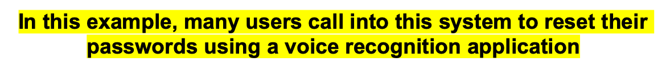

An Example of a Web Service Testing
3rd Party Hosting Voice Application
Users’ Info
Password Reset Web Service
Users’ Info
ABC Company Password Reset
Back End Services
Users of the ABC Co. call to reset their passwords
Status = Success
Or
Failure
Success
Or
A Failure
All RESTful service responses going to have “status” property, the possible values are “SUCCESS”, “FAILURE”. In case of failure, the 3rd Party Hosting Voice Application is notified with one of the error code messages listed below:
Error Code | Error Message | Scenario
1010 | Password reset service is not available | System unavailable
1011 | User account is not active | Not active user or not valid user
1012 | This function is not available for this account | Black listed user or physician
1013 | Password reset attempt failed | Internal error or sync error
1014 | Password complexity failed | Password does not adhere to Fresenius password policy

Slide 38
References
https://www.softwaretestinghelp.com/web-services-testing-tools/
https://medium.com/@alicealdaine/top-10-api-testing-tools-rest-soap-services-5395cb03cfa9
https://www.inflectra.com/Rapise/HelpReadingPane.ashx?filename=Rapise2.0.0.chm&href=tutorial_web_services_rest.htm
RESTful Web Services: Representational State Transfer (REST) is an architectural style that specifies constraints, such as the uniform interface, that if applied to a web service induce desirable properties, such as performance, scalability, and modifiability, that enable services to work best on the Web.

